Slide 1



Design for Six Sigma Green Belt Certification
Project Template
Dr. Marcelo Machado Fernandes
Lean Six Sigma Master Black Belt
ASQ MBB | Minitab CTP

Slide 2
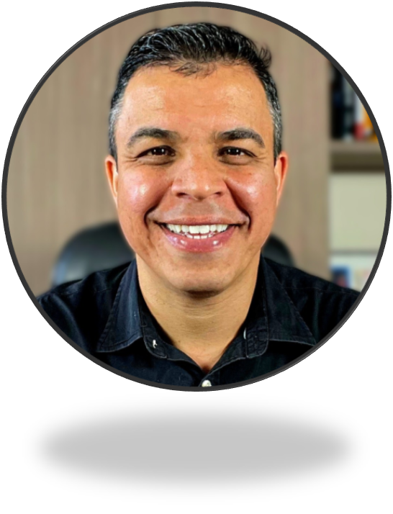
Prof. Marcelo Fernandes, PhD
Prof. Marcelo Fernandes, PhD is a globally recognized expert in Operational Excellence, Lean Six Sigma, and innovative learning methodologies. Over the past two decades, he has developed a unique and highly engaging teaching approach, delivered through virtual, in-person, and blended learning environments, that combines Lean Six Sigma concepts with gamification, active learning strategies, and real-world application.
With more than 25 years of international experience, Marcelo has designed and deployed continuous improvement programs and Operational Excellence strategies across a wide range of industries, consistently delivering outstanding business results, including ROI exceeding 20:1 and near-zero defect performance in critical processes.
Marcelo is an official Minitab Training Provider and a passionate advocate for making complex concepts simple, practical, and impactful.
He holds both a PhD and a Master’s Degree in Industrial Engineering, with research focused on Operational Excellence and Lean Six Sigma. Throughout his career, he has trained more than 150,000 professionals from over 100 countries and has mentored and coached more than 500 improvement projects across manufacturing, healthcare, service, and transactional environments.
Bridging the gap between academia and industry, Marcelo has built a distinguished career in both worlds. His mission is to empower professionals and organizations to achieve breakthrough results through practical excellence, continuous learning, and a belief that passion, simplicity, and disciplined execution can transform processes, and lives, for the better.

Slide 3
Education is not the filling of a pail, but the lighting of a fire.
(William Butler Yeats)

Slide 4
The DMADV Roadmap
Define
Analyze
Verify
1
3
5
2
4
Measure
Design

Slide 5
DMADV Roadmap
DEFINE
1 – Define Customer Segment
2 – Collect VoC
3 – Classify VoC
MEASURE
4 – Prioritize VoC
5 – Translate VoC into CTQs
6 – Prioritize CTQs
ANALYZE
7 – Identify Potential Concepts
8 – Prioritize Potential Concepts
9 – Identify Winning Concept
DESIGN
10 – Identify Critical Factors (Xs)
11 – Model Process
12 – Optimize Process
VERIFY
13 – Evaluate Risk
14 – Verify Final Performance
15 – Create SOP

Slide 6
Case Study
Alice has always dreamed of creating a signature pizza that people would genuinely love and recommend to their friends and family. She knows that an unforgettable customer experience depends not only on outstanding quality but also on delivering every pizza quickly and consistently. Instead of hoping customers will like the final result, Alice wants to create a pizza that exceeds their expectations from the very first order and keeps them coming back for more.

Slide 7
DEFINE
1
D
M
A
D
V

Slide 8
Define Customer
Segment

Slide 9
Define Customer Segment
D
M
A
D
V
Defining Customer Segment has more to do with Voice of the Business (VoB) than Voice of the Customer (VoC)!!!
You need to understand what kind of game business owner wants to play!!

Slide 10
Define Customer Segment
D
M
A
D
V
How can we listen to the VoB and understand the type of game business wants to play?
1:1 interviews with business owner to understand business strategy (spoken and unspoken VoB)!!!
Observe and investigate current business nature! Type of current products and services!
Talk to people that know the business (not necessarily
The business owner).

Slide 11
Define Customer Segment
D
M
A
D
V
Alice wants to promote the most amazing “explosion of flavor” possible to people that does not like meat (vegetarian pizza) to the largest number of people possible!
She wants to promote an amazing experience in terms of pizza to people that normally would never have the chance to pay for expensive pizzas!
So, basically a premium pizza to people that struggle financially!!

Slide 12
Define Customer Segment
D
M
A
D
V
Customer Segment Characteristics:
Young people (18 - 25 years old)
People that study in universities
People in Itajubá-MG (Brazil)
People that have financial difficulties
People that like pizzas without meat (bacon, peperoni, etc)

Slide 13

Define Customer Segment
D
M
A
D
V

Slide 14
Collect Voice
of the Customer

Slide 15
Collect VoC
D
M
A
D
V
We need to talk about sampling!! Our sample must be:
1 - Sufficient: as a simple reference consider as a starting reference 100 data points! Minimum 30 data points!
2 - Contextual: pay attention to the context when you are collecting your VoC! It must be connected to the research objectives!!

Slide 16
Collect VoC
D
M
A
D
V
We need to talk about sampling!! Our sample must be:
3 - Reliable: Data should be collected using reliable measurement systems!
4 - Well segmented: your sample must be totally connected to the previously defined customer segment!
5 - Random: the entire population should have the same (or known) chances to be selected.

Slide 17
Collect VoC
D
M
A
D
V
1 - "I want the most delicious vegetarian pizza I've ever tasted!"
2 - "I need a pizza that fits my student budget."
3 - "I want fresh vegetables, not frozen or soggy toppings."
4 - "I hate waiting too long for my pizza, especially between classes."
5 - "I want a crispy crust on the outside but soft on the inside."
6 - "I want enough cheese, but I don't want my pizza to feel greasy."
7 - "I want a pizza big enough to share with my friends."
8 - "I want exciting vegetarian toppings, not just tomatoes and onions."
9 - "I want to customize my pizza according to my preferences."
10 - "I want every pizza to taste just as amazing as the last one."

Slide 18
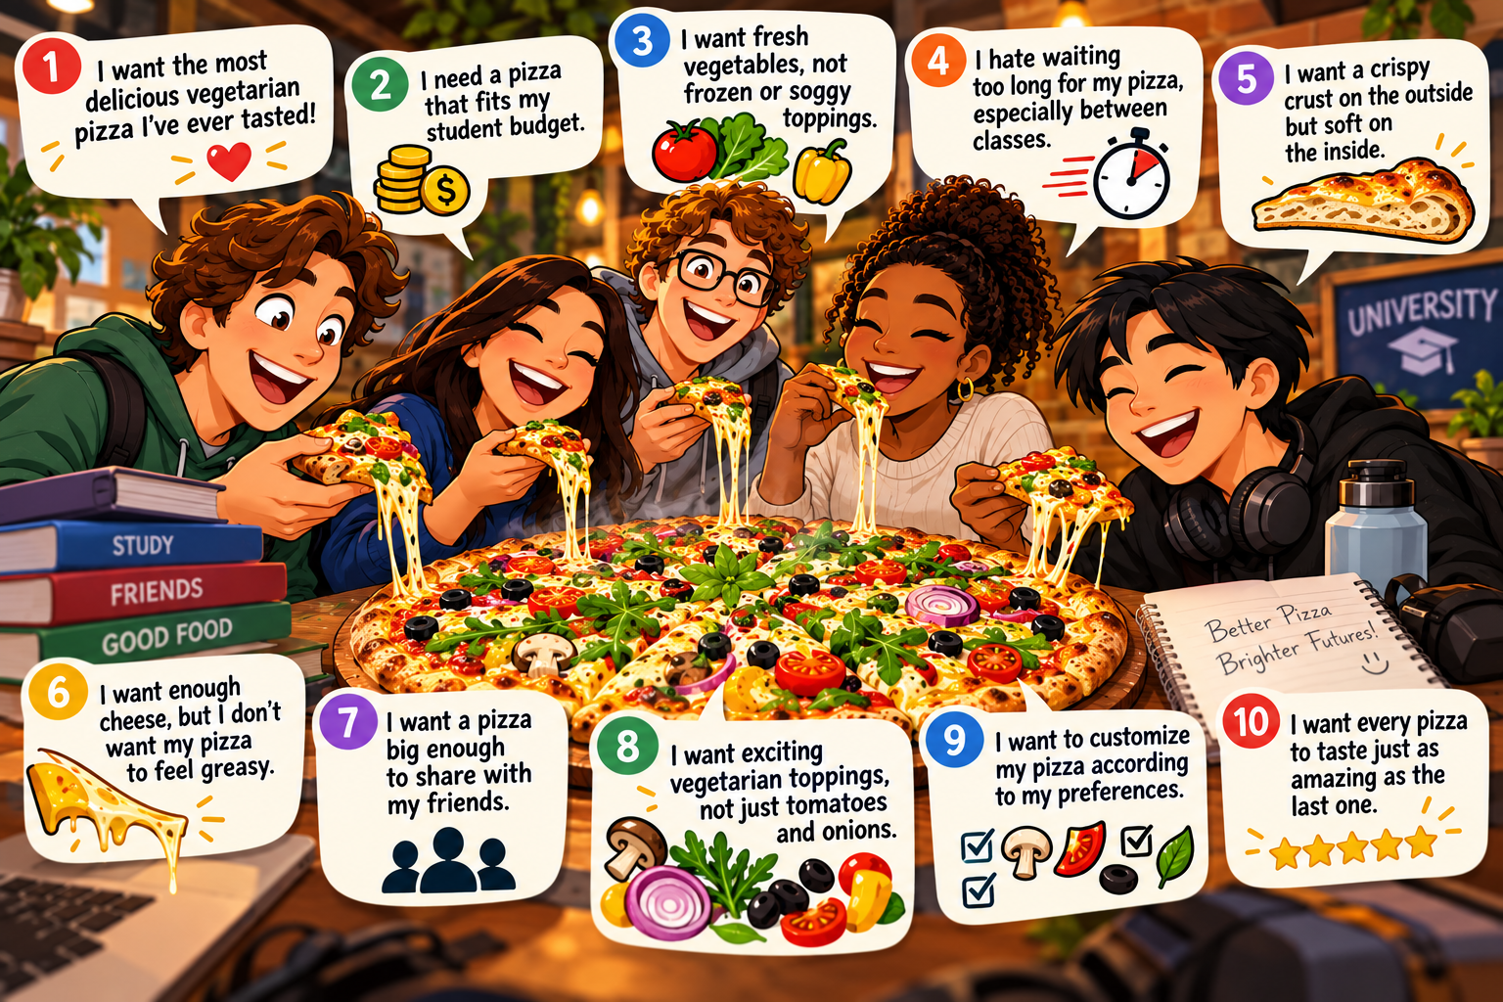
Collect VoC
D
M
A
D
V

Slide 19
Classify Voice of the Customer

Slide 20
Classify VoC
D
M
A
D
V
We will be using Kano Model!
1 - Must be / Must have (Mandatory): non negotiable characteristics of the product / service.
2 - Linear: characteristics like “more is better” (quality) and “less is better” (delivery time and price).
3 - Delighter: unexpected positive characteristics in the product/service

Slide 21
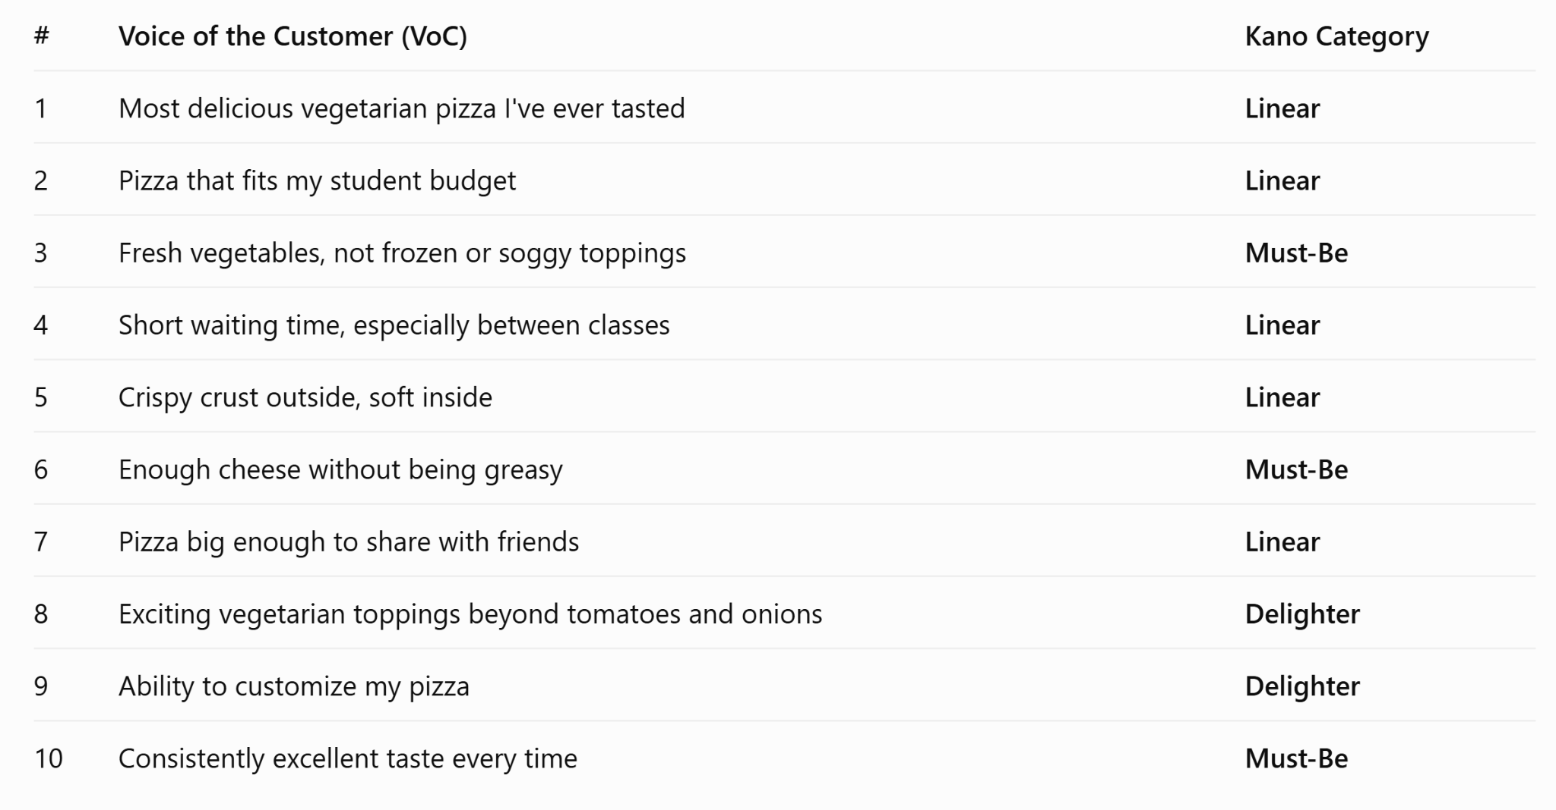
Classify VoC
D
M
A
D
V

Slide 22
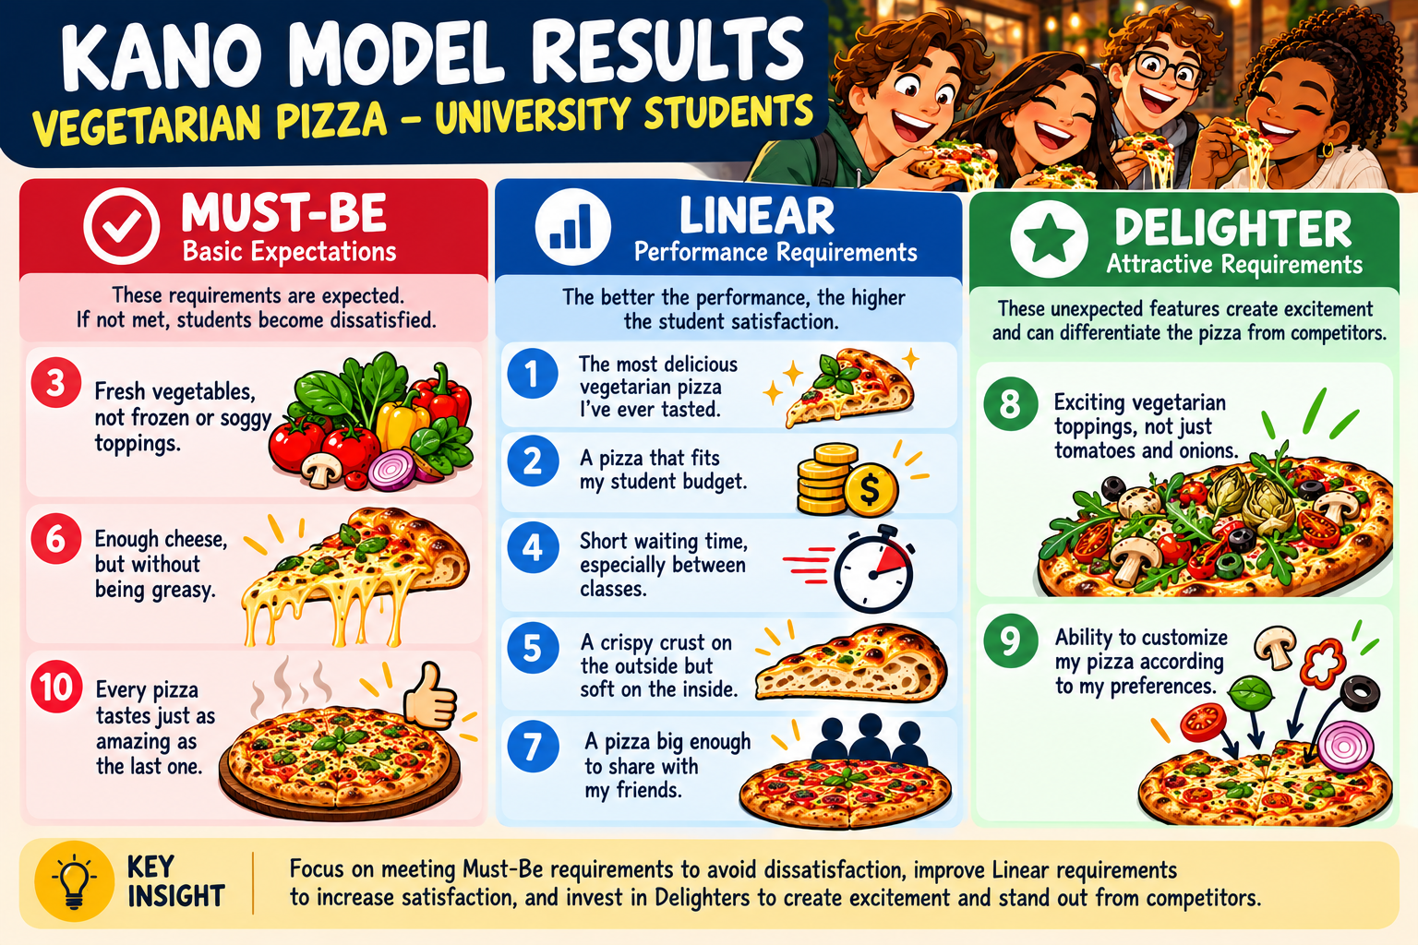
Classify VoC
D
M
A
D
V

Slide 23
MEASURE
2
D
M
A
D
V

Slide 24
Prioritize VoC
D
M
A
D
V

Slide 25
Translate VoC into CTQs
D
M
A
D
V

Slide 26
Prioritize CTQs
D
M
A
D
V

Slide 27
ANALYZE
3
D
M
A
D
V

Slide 28
Identify Potential Concepts
D
M
A
D
V

Slide 29
Prioritize Potential Concepts
D
M
A
D
V

Slide 30
Identify Winning Concept
D
M
A
D
V

Slide 31
DESIGN
4
D
M
A
D
V

Slide 32
Identify Critical Factors (Xs)
D
M
A
D
V

Slide 33
Model Process
D
M
A
D
V

Slide 34
Optimize Process
D
M
A
D
V

Slide 35
VERIFY
5
D
M
A
D
V

Slide 36
Evaluate Risk
D
M
A
D
V

Slide 37
Verify Final Performance
D
M
A
D
V

Slide 38
Create SOP
D
M
A
D
V

Slide 39
Customer satisfaction!!!
Celebrate!
Recognize!

Slide 40

Slides provided by Slides Carnival
Free templates for all your presentation needs
For PowerPoint and Google Slides
100% free for personal or commercial use
Ready to use, professional and customizable
Blow your audience away with attractive visuals

